Slide 1





Chitkara University
Project name: IWT Project(Film Review website)
Submitted to: Mrs. Kanwalpreet Kour
Submitted by: Urva Sharma
Roll no. : 1910990682
Batch: 3Q-02

Slide 2
INTRODUCTION
The website is a Film review Website and name of the website is “SSR Reviews”.
The first page of the website is a Sign up form, which asks for name, phone no., email id and a password.
The second page of the website is the introduction about this website.
The third page onwards, there is a detailed info of some of the films of an actor.
A similar website can be created for any actor or any book or novel as one wishes to.

Slide 3
USE OF HTML
In this website, I have used various HTML tags.
The img(image) tag has been used to set the background of all the pages as well as to add all the images of the actors in this website.
The fieldset tag has been used to group several controls as well as labels within this web form.
The form tag has been used to create a form for the user. This form contains labels, inputs field of type text, email, password and number.

Slide 4
USE OF HTML(cont…)
The button tag has been used to create clickable button on this webpage.
The table tag has been used to align the contents of the webpage in the first page.
The anchor tag has been used to link the web pages. Also, it has been used as a link to external webpages.

Slide 5
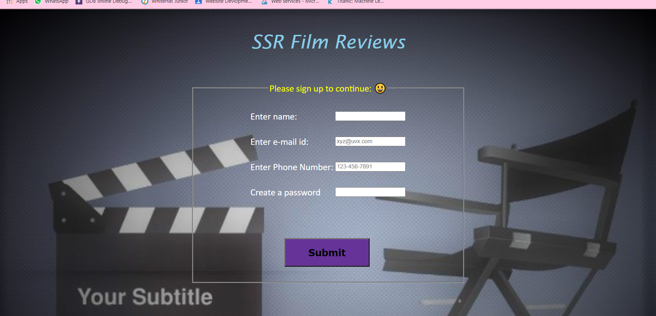
SIGN UP PAGE
Emoticons
Text validation
Fieldset tag used

Slide 6
USE OF CSS
CSS: Cascading Style Sheets
In every page of the website, I have used the font attributes such as font family to set the style of the font, font color to set the color of the text and the font size to set the size of the text in the website.
The margin tag has been used to set the top and left margins for images as well as text in the website.
The float property has been used to set the element on the left or right of its container.

Slide 7
USE OF CSS (cont…)
The border tag has been used to give borders to the images. Different styles of the border tag have been used.
UTF-8: 8 bit Unicode Transformation Format. This has been used to add an emoticon in the legend tag .
Different emoticons use different HTML code in the decimal format. For e.g. :&#128515
Using the hover and opacity property, image effects have been added on some of the images.

Slide 8
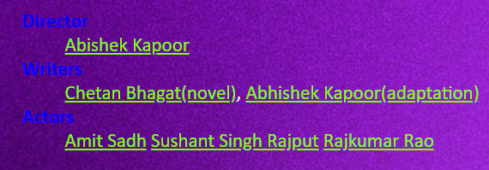
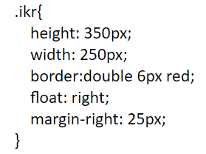

USE OF FONT ATTRIBUTES
Float property used
Different Border colors and styles for every image

Slide 9
USE OF JAVASCRIPT
In this website, I have used JavaScript only in the form validations.
For Example:
If phone type entered
Is invalid
Alert will be ”Pl enter a valid mobile no.”
If email is entered incorrectly
Alert will be “Pl enter a valid email address”
If password length or type is entered incorrect
Alert will be “pl enter a valid password type”

Slide 10
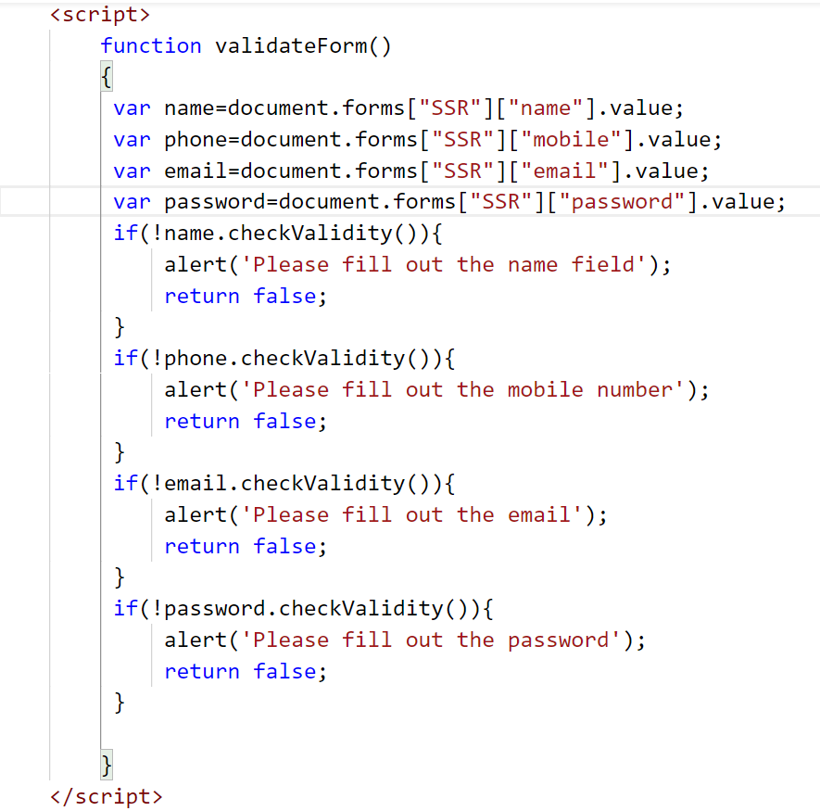
DOM form validation
Input fields accessed using array methods
Use of function
checkValidity()
Alerts used for the user to fill the fields

Slide 11
Thank you!!!

